Slide 1
Introduction to
Emotional Intelligence

Slide 2
Agenda
Emotional Intelligence-The concept
What exactly is EQ
Three skills of Emotional Intelligence
How does EQ make a difference in one’s life
Conclusion

Slide 3
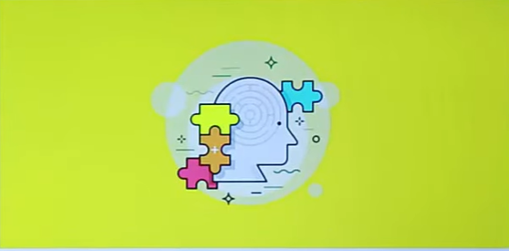
Concept of Emotional Intelligence
Peter Salovey and John D. Mayer coined the terms ‘Emotional Intelligence’ in 1990.

Slide 4
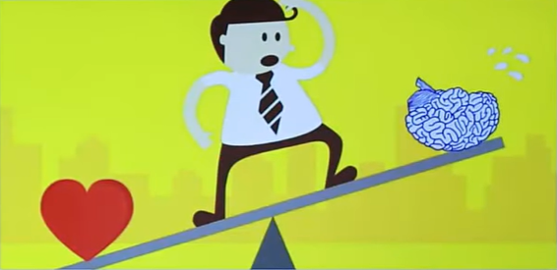
What is Emotional Intelligence?
The capacity to be aware of, control and express one’s emotions, and to handle interpersonal relationships judiciously and empathetically.

Slide 5
Skills of Emotional Intelligence
Emotional Intelligence
Self Awareness
Motivation
Self Regulation

Slide 6
How does EQ affect our Lives?

